Slide 1

Diabetes - The Future Chronic Disease
Feature Detection, Classification and Identification

Slide 2
Introduction
This Project is based on the Method of Feature Selection, where we are going to work on a Dataset and try improving the Accuracy of the Outcome in that Dataset.
Here we will have to make use of the available features from the given data, and perform several operations to calculate the Accuracy of the Outcome developed by the given data.
We have made use of a Dataset related to Diabetes Measures on which we will be performing the task of Feature Selection.

Slide 3
The Method of Feature Selection is applied in the real world scenarios to get much Accurate output of the data.
This makes the handling of large data very much easier and accessible .
It would help us to gather the required set of data from a large bulk.

Slide 4
Problem Statement
Perform the task of Feature Selection on a dataset, and show the improvement in the Accuracy of the Outcome.

Slide 5
AIM
To improve the Accuracy of the Outcome by performing the task of Feature Selection.
Objective
Feature Selection would be performed by selecting the required features, based on their respective Correlation Coefficient Value.

Slide 6
Overview of Project
We have chosen a dataset consisting of 11 features, which would influence the Outcome of the dataset. The task of Feature Selection is implemented to reduce the number of features by selecting the ones which would have greater impact on the Outcome. This choosing process has been done by considering the Correlation Coefficient values of the Features. The Accuracy of the Outcome would improve automatically as the task of Feature Selection is performed. We have the shown the Accuracy value of the outcome, before and after performing Feature Selection.

Slide 7
Methodology
There are 2 main methods which are followed in the Project.
One is of reducing the number of Features by calculating the Correlation Coefficient values of the Features, and choosing the ones which have greater Correlation Coefficient value among them .
The Other method is of calculating and printing the Accuracy of the Outcome . This Accuracy calculation part is performed with the help of several different functions( DecisionTreeClassifier, SVM , KNN ) of Python.

Slide 8
Work Done (or) Implementation

Slide 9
DIABETES DATASET
This dataset is originally from the National Institute of Diabetes, Digestive and Kidney Diseases. The Objective of the dataset is to diagnostically predict whether or not a patient has diabetes, based on certain diagnostic measurements included in the dataset. Several constraints were placed on the selection of these instances from a larger database. In particular, all patients here are females at least 21 years old of Pima Indian heritage.
The datasets consists of several medical predictor variables and one target variable, Outcome. Predictor variables include the patient's BMI, insulin level, age, and so on.

Slide 10
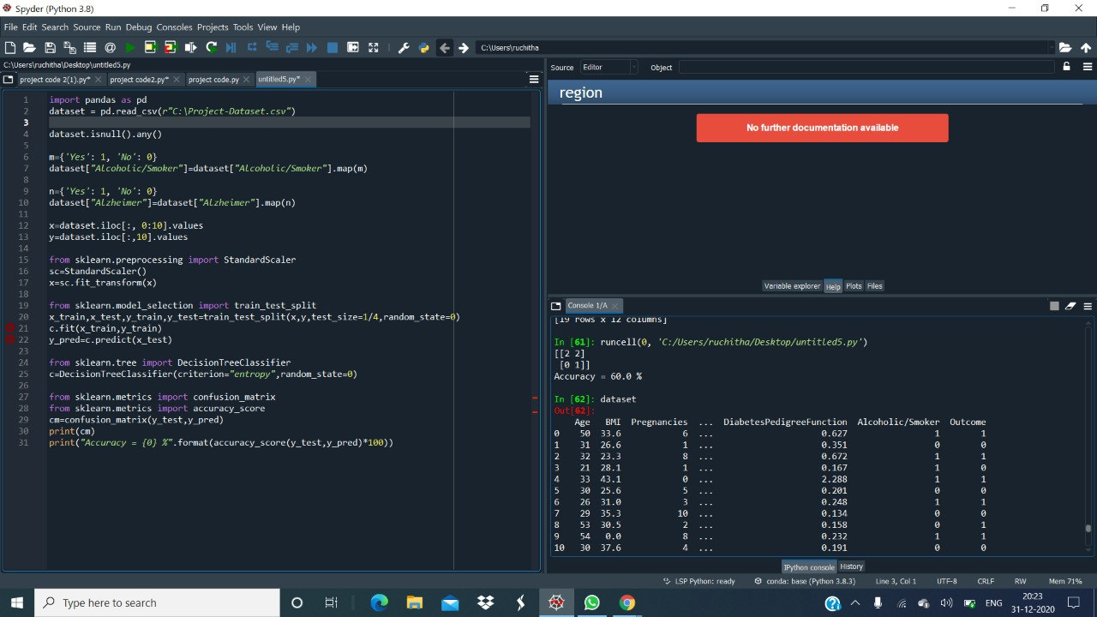
PROGRAM

Slide 11
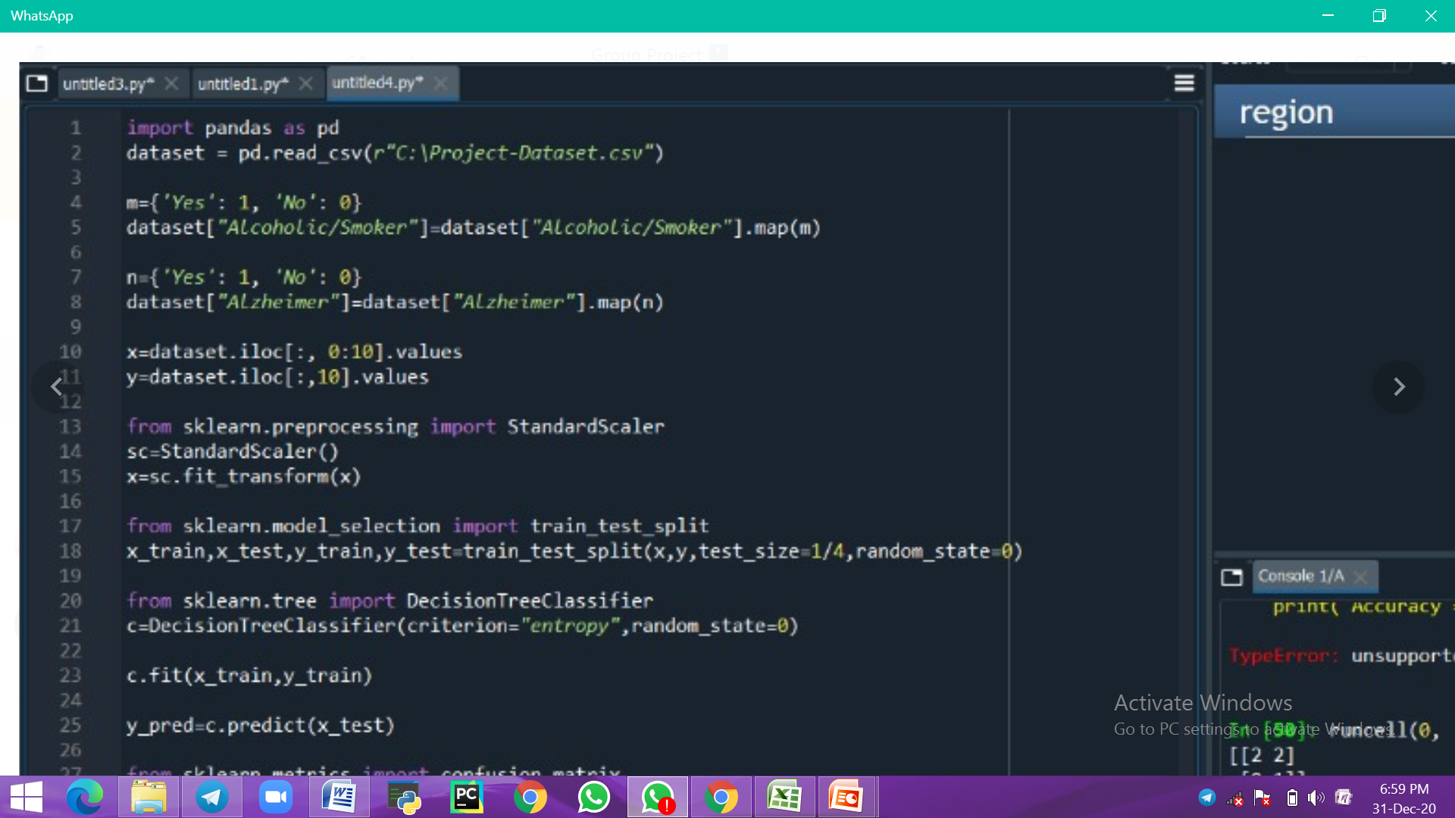
We will have to first include our Dataset into the IDLE. So we will be using a inbuilt package called Pandas for this inclusion of the dataset, and then we will include the dataset by calling a function called { read_csv } in the program. So by performing this part, the required dataset will get included into the IDLE for further execution.

Slide 12
We will have to check whether there are any Missing Values present in the dataset . In case of missing values present in the dataset, we will be filling those particular values by the mean value of that particular set, by using a function { fillna(dataset[" "].mean() }

Slide 13
There will be several sets of Categorical Values as features in the Dataset. We will have to convert these Categorical values into Numerical Values for proper execution of our Program. We will be converting them in the manner shown above. Once these values get converted, they will be in a usable format for our proceedings.

Slide 14
The dataset contains a set of Independent Variables and one Dependent Variable. The Dependent Variable will be the final outcome of the Dataset and the Independent Variables will be the deciding factors of the final outcome. So we will be split these Complete set of Variables into Dependent and Independent ones, and we will assign Dependent Variables to (x) and Independent Variables to (y).

Slide 15
There will be a few values in one particular set which will be of a very high number than the remaining. These few values of that particular feature will dominate the remaining features, and make them less effective in the dataset. Through this the dataset will become less efficient because of the domination of those high numbers. To avoid this inefficiency of the dataset, we will use the method of Normalizing, through which we will bring the entire set of numbers into a small interval and make sure that all the numbers in that particular set will be useful for the efficient outcome of the dataset.

Slide 16
There are two set of methods which we will have to proceed with for the calculation of the outcome. They are particularly Training and Testing. We will first give a few set of values for training, through which we will be finding out the outcome of that set of values. Then we will predict the outcome of the remaining set of values through the Testing method. This will be done by the help of the set of values which were given for training in the beginning. In this way the outcome of all the values will be found out.

Slide 17
Now we have got the Final Outcome values by the execution of feature selection method. These outcome values will now be used to calculate the count of TP,TN,FP,FN values and these values will be shown in the form of a matrix known as Confusion Matrix. Now the Accuracy of the Outcome will be calculated by using the values present in the Confusion Matrix. This will be done by importing a package called { sklearn }, which will process the values to find the Accuracy Value.

Slide 18
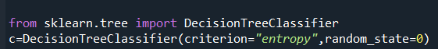
Here we have used the Classification Method of DecisionTreeClassifier which performs the task of Accuracy Calculation of the Outcome. This Method uses the Outcome values of the Dataset and performs a few other operations in order to Calculate the Accuracy

Slide 19
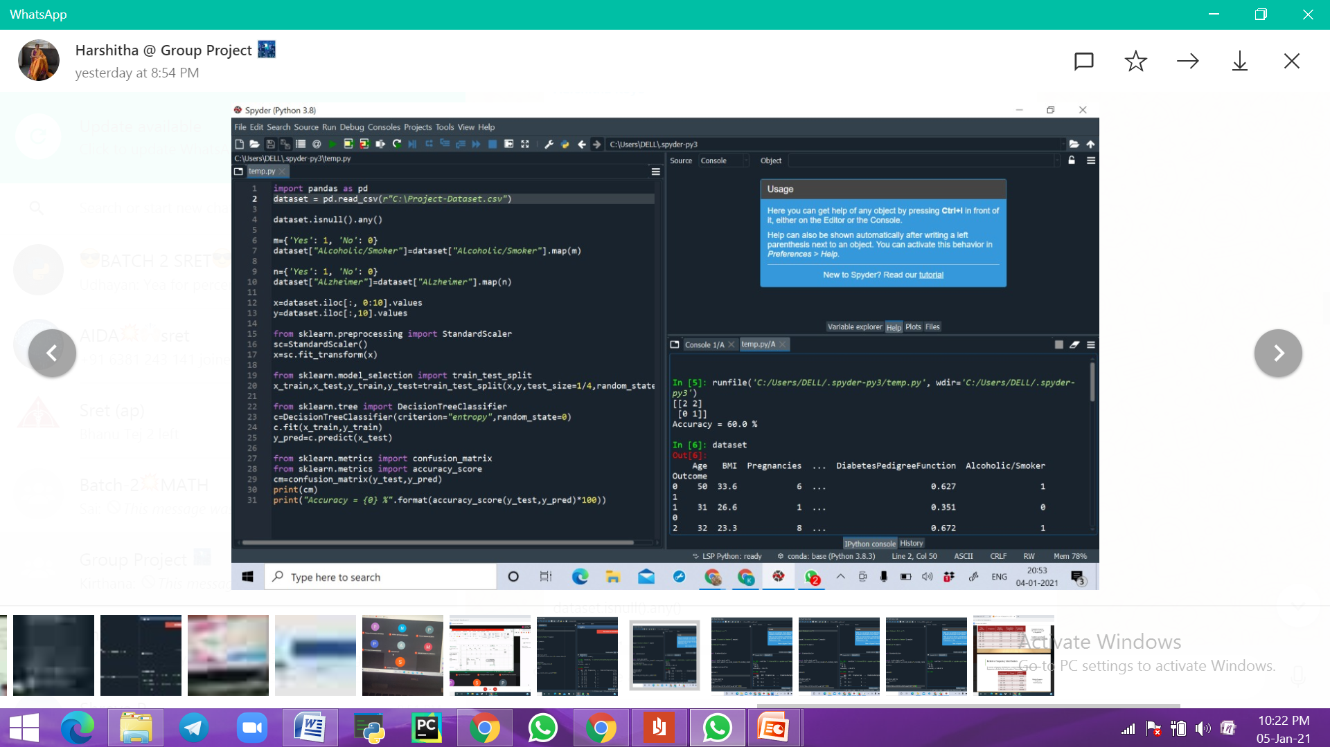
This is the Output obtained by using Decision Tree Classifier Function of python, where an Accuracy of 60.0% has been calculated.

Slide 20
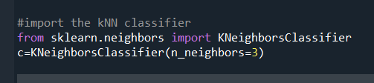
Here we have used the Classification Method of KNN which performs the task of Accuracy Calculation of the Outcome. This Method uses the Outcome values of the Dataset and performs a few other operations in order to Calculate the Accuracy

Slide 21
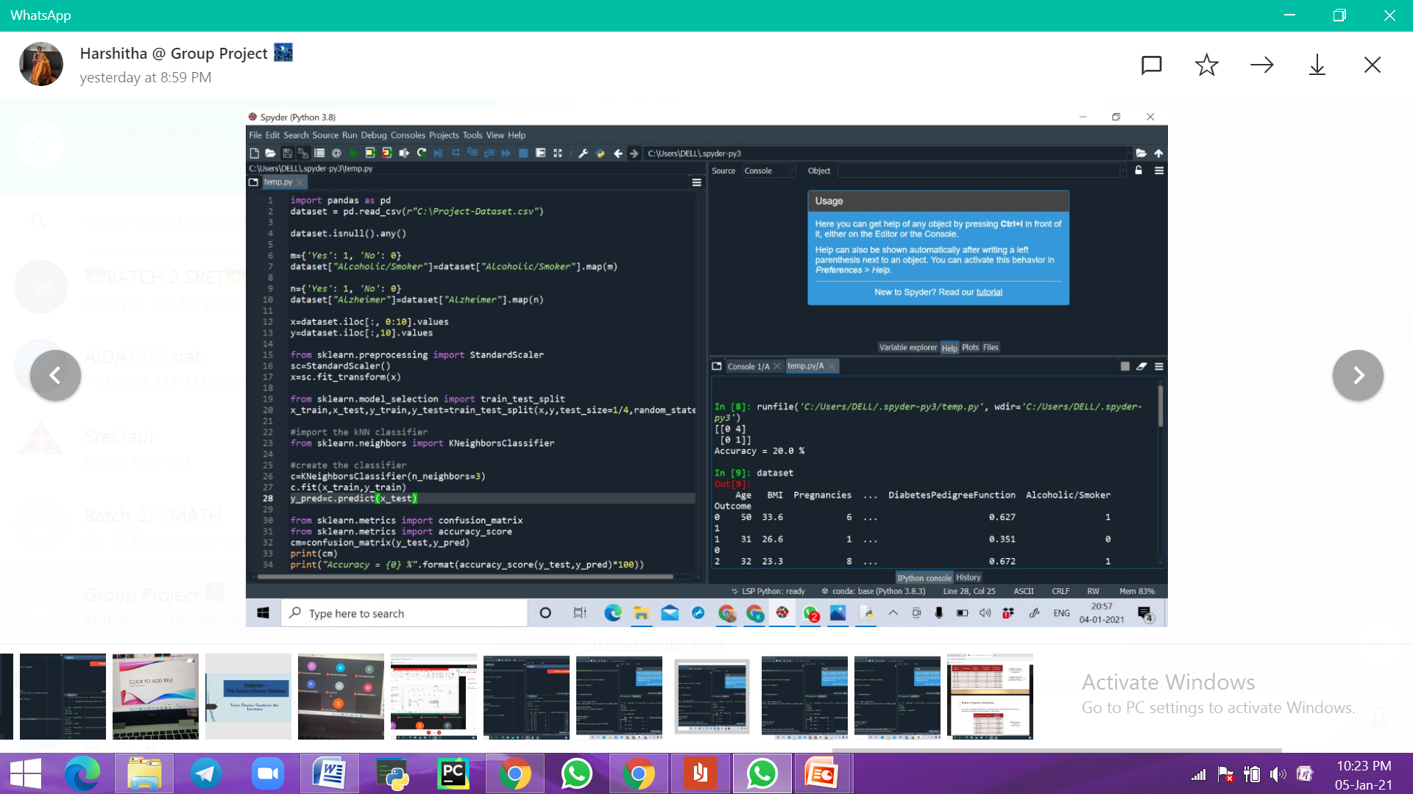
This is the Output obtained by using KNN Function of python, where an Accuracy of 20.0% has been calculated.

Slide 22
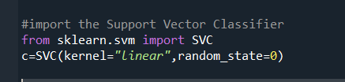
Here we have used the Classification Method of SVM which performs the task of Accuracy Calculation of the Outcome. This Method uses the Outcome values of the Dataset and performs a few other operations in order to Calculate the Accuracy

Slide 23
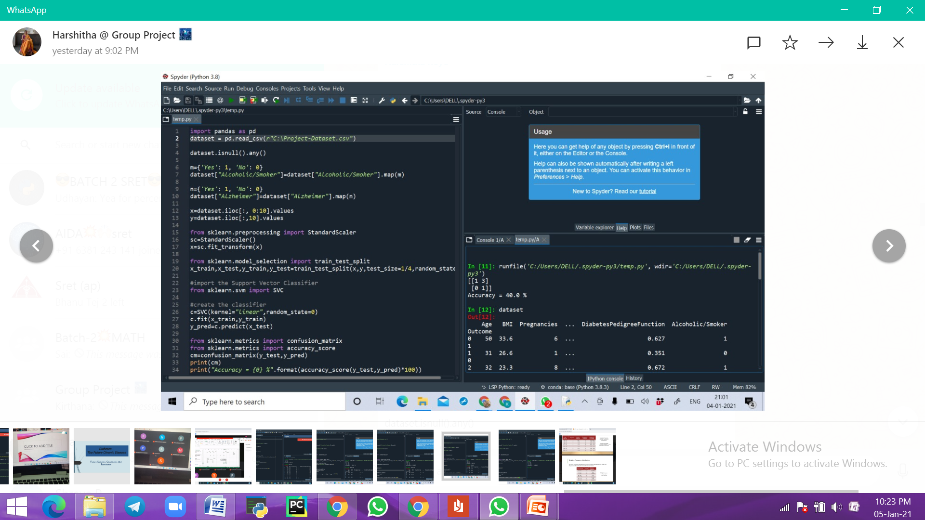
This is the Output obtained by using SVM Function of python, where an Accuracy of 40.0% has been calculated.

Slide 24
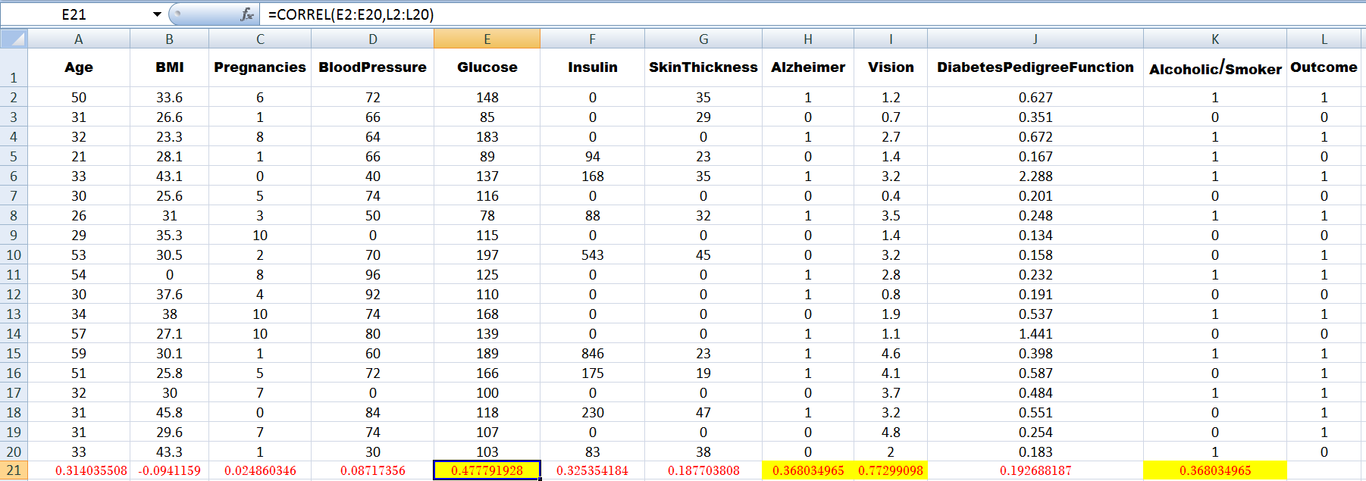
The task of Feature Selection has to be performed now. This task needs the calculation of Correlation Coefficient Values of the Features in the Dataset. These values are calculated in Excel by the formulae of { =CORREL(A2:A20,L2:L20) }. Then the features would be selected based on the values calculated.

Slide 25
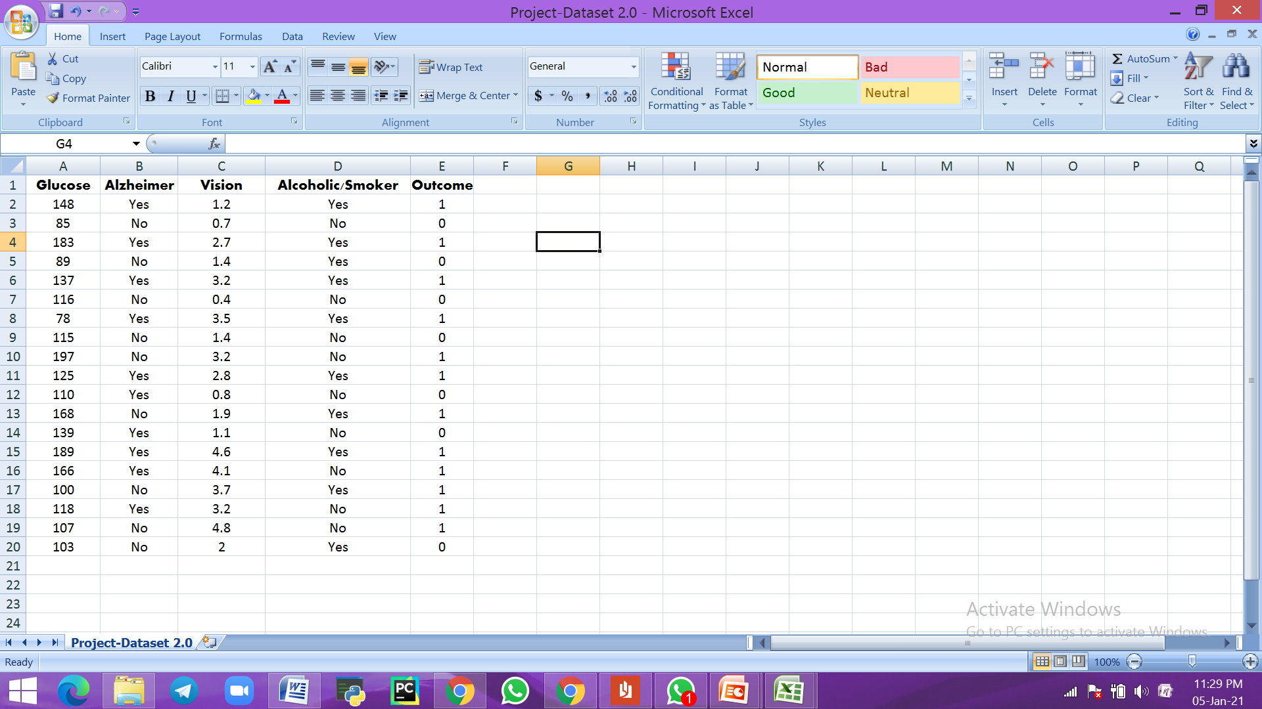
A few set of features which have higher Correlation Coefficient Values are now selected . Then the task of Feature Selection has been completed. The Accuracy of this set of features will now be calculated, in order to check the difference in the Accuracy Value after performing Feature Selection.

Slide 26
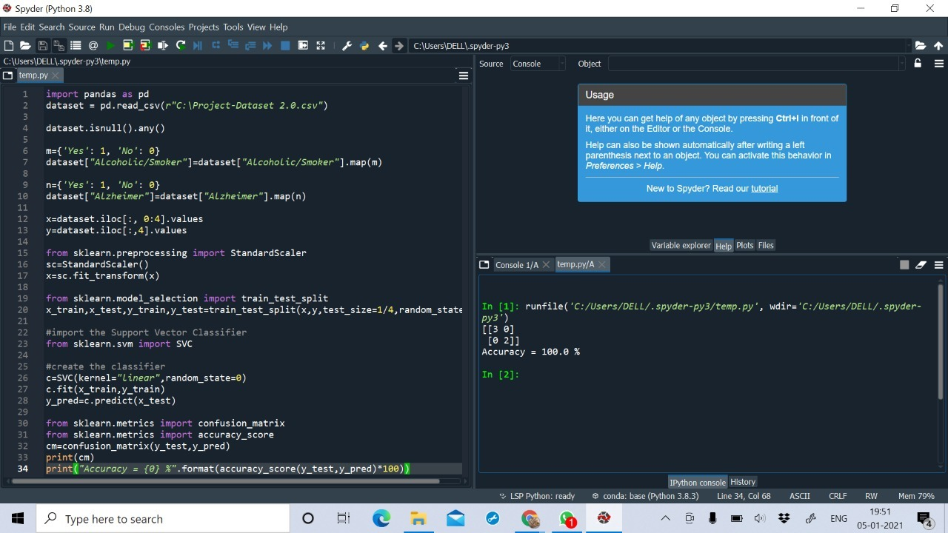
The task of Accuracy Calculation of the Feature Selected Dataset has been performed, by the use of SVM function of Python. This dataset has only the set of selected features which were chosen before, based on their respective Correlation Coefficient Values.

Slide 27
This is the Accuracy Output of the Feature Selected Dataset obtained by the use of SVM function of Python, where an Accuracy of 100.0% has been Calculated

Slide 28
Result

Slide 29
This Shows the set of Accuracy Values before and after performing Feature Selection. There is a drastic change in the value of Accuracy after performing feature selection as 100.0% as compared to the Accuracy values before shown as 60.0%, 20.0% and 40.0% . Therefore this states that the Method of Feature Selection would improve the Accuracy Value by the selection of necessary features for that particular required outcome.

Slide 30
Reference
Kaggle ( Dataset ) - https://www.kaggle.com/uciml/pima-indians-diabetes-database
Udemy ( Python Programming ) - https://www.udemy.com/course/learn-machine-learning-from-scratch-in-python/
Correlation Coefficient Calculation - https://www.excel-easy.com/examples/correlation.html

Slide 31
Group Members : Neeraj Boyapati Shreya P Medam Bhanu Tej Koye Harshitha Potturu Abhiram Pamulapati Kirthana Ponnuru Sai Venkatesh

Slide 32


